Slide 1
Predicting Medical Insurance Charges Using Personal Attributes
Course: ai course weekly assignment
Dataset: medical cost personal dataset (kaggle)
Prepared by: basma muhaned joulani, raneen ibrahim ladadweh

Slide 2
Which Personal Factors have the greatest Impact on medical insurance charges, and can we use these factors to predict a person’s medical costs?
Objectives: -
Analyze factors affecting insurance charges.
Clean and preprocess the dataset.
Visualize important patterns.
Prepare the dataset for machine learning.

Slide 3
Dataset Description
Dataset Source: Kaggle, Medical cost personal dataset
Dataset Features: -
Age
Gender
BMI
Number of Children
Smoker/ Non-smoker
Region
Charges (Target variable)

Slide 4
About the project
The project type is Regression, that's because the target variable (Charges) is numerical, as we want to predict a continuous value (medical cost).
The feature we need to predict the variable is age, BMI, number of children, and the categorical features are gender, smoke or not, and their region.

Slide 5
Training and testing
1070 Training
268 Testin
1338 Charges

Slide 6
Data Exploration

Slide 7
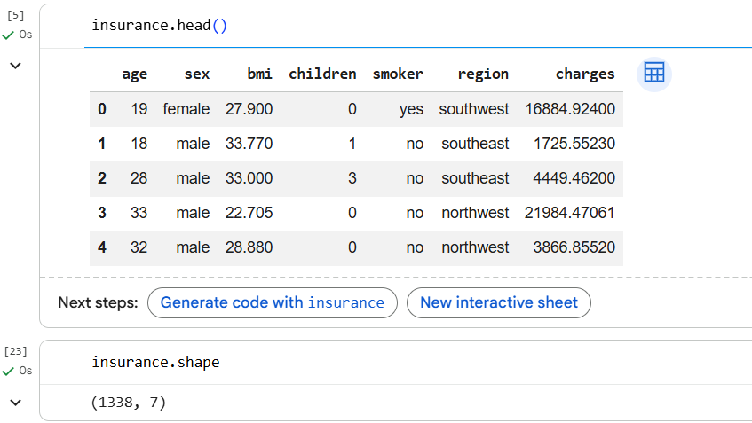
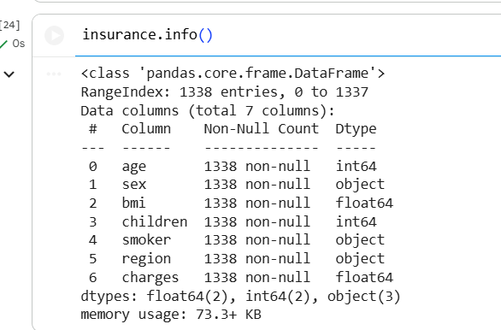

Slide 8
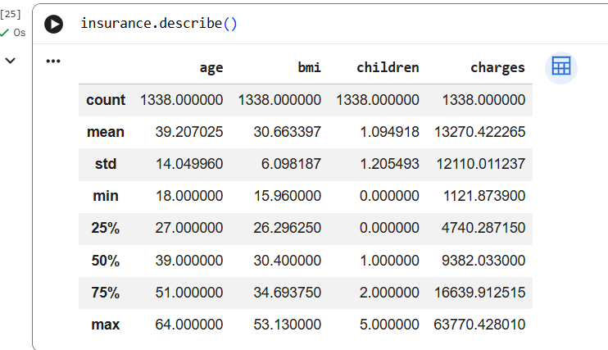

Slide 9
Data Preprocessing

Slide 10
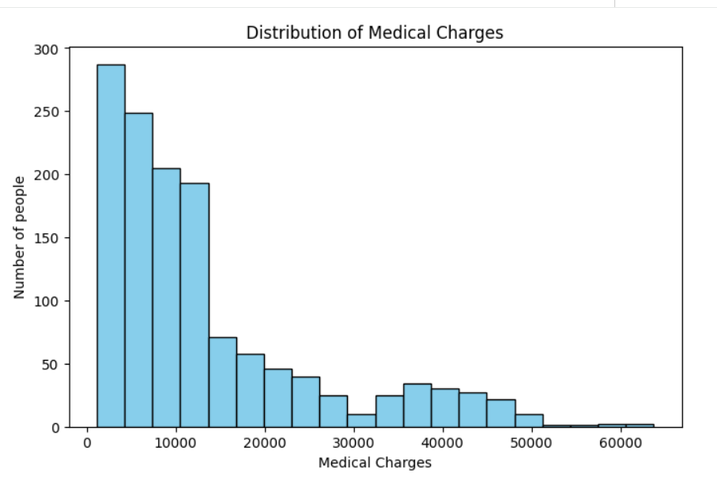
Histogram of Medical Charges

Slide 11
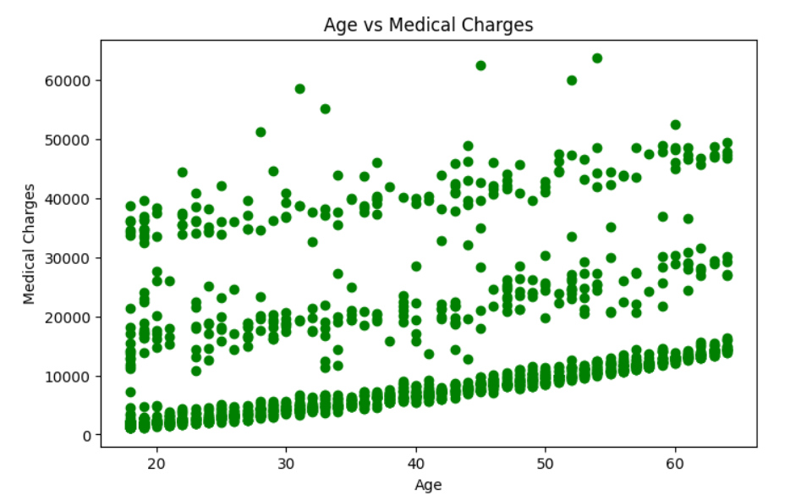
Age vs Charges Scatter Plot

Slide 12
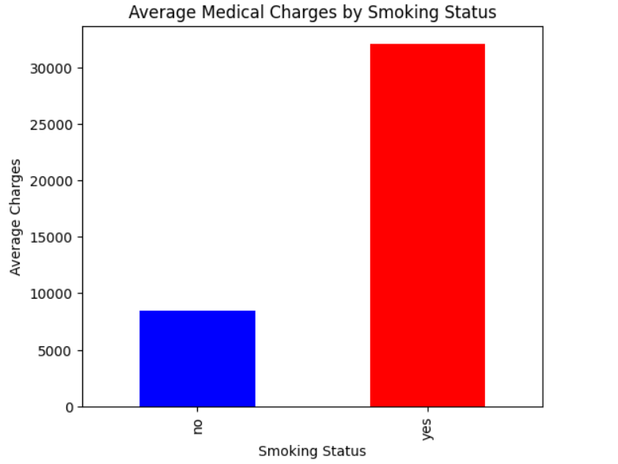
Smoking Status vs Charges Bar chart

Slide 13
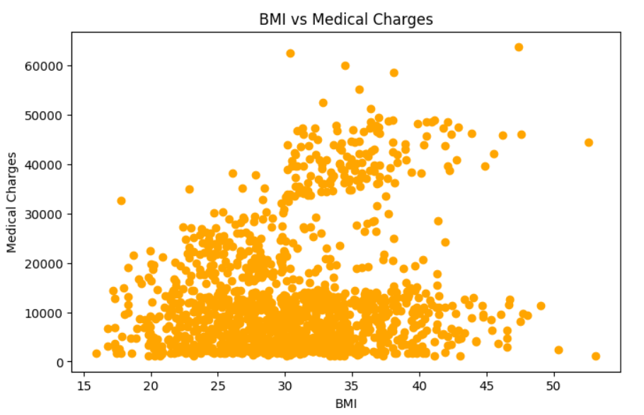
BMI vs Charges Scatter plot

Slide 14
Three Important Insights
Smoking significantly increases medical insurance costs.
Older indivisuals tend to have higher healthcare expenses.
Higher BMI is associacted with higher insurance charges.

Slide 15
Conclusion
The Medical Cost Personal Dataset was cleaned and analyzed successfully.
Smoking status, age, and BMI were the most influential factors affecting insurance charges.
The dataset was preprocessed and prepared for machine learning.
These factors can be used to predict future medical insurance costs.

